Slide 1




14,15,21,22 November 2015

Slide 2
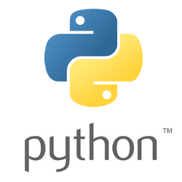
Day 1 – Python Programming
Outlines
Introduction to Python
Basic Syntax
Flow Control
Loops
Function and Class
Files I/O

Slide 3

Introduction to Python
Guido van Rossum believes that using indentation for grouping is extremely elegant and contributes a lot to the clarity of the average Python program
https://en.wikipedia.org/wiki/Guido_van_Rossum

Slide 4
why Python ?
Interpreted
not need to compile your program before executing
Interactive
Interact with the interpreter directly to write your programs.
Object-Oriented
Easy, Fast, Broad, Easy and Open Source

Slide 5
Lines and Indentation
There are no braces to indicate blocks of code in Python
to indicate blocks of code for class and function definitions or flow control
Blocks of code are denoted by line indentation
The number of spaces in the indentation is variable,
but all statements within the block must be indented the same amount

Slide 6


Basic Syntax
Variable
No explicit declaration
Standard data type :
numbers, string, list, tuple, dictionary

Slide 7
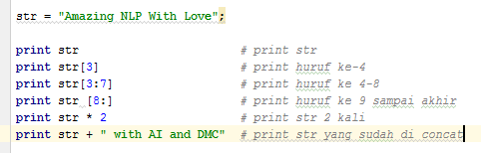
Basic Syntax
Printing text to the Screen
Output option
Concatenate using (,) to add space between
Concatenate using (+) to full concatenation

Slide 8
Basic Syntax
Reading Keyboard Input
var = raw_input(‘text’)
reads one line from standard input and returns it as a string
var = input(‘text’)
assumes the input is a valid Python expression and returns the evaluated result
str = raw_input("Masukkan inputan string: ")
print "inputan adalah : ", str
x = input("Masukkan inputan: ")
print "inputan adalah : ", x

Slide 9
Basic Syntax
List vs Tuple
Tuple : read only list, elements and size cannot be changed,
List enclosed with [ … , … ]
Tuple enclosed with ( … , … )
Access and modify using [ index ] or [ start : end ]
Concatenate using (+)

Slide 10
Basic Syntax
Dictionary
Hash table type
Consist of key and value
enclosed with { key : value, … : … , … : … }
Set value using [ key ] = value
Print all keys using print dict.keys()
Print all values using print dict.values()

Slide 11
Basic Syntax
List, Tuple, and Dictionary Built-in Functions
function | Avlb.
cmp( x , y ) | all
len( x ) | all
max( x ) | List, Tuple
min( x ) | List, Tuple
list( t ) | List
tuple( l ) | Tuple
function | Avlb
list.append(obj) | List
list.count(obj)
list.extend(seq)
list.index(obj)
list.insert(index, obj)
list.pop(obj=list[-1])
list.remove(obj)
list.reverse()
list.sort([func])
function | Avlb
str(dict) | Dictionary
type(variable)
dict.clear()
dict.copy()
dict.fromkeys()
dict.get(key, default=None)
dict.has_key(key)
dict.items()
dict.setdefault(key, default=None)

Slide 12
Let’s try it…
delivery = ['munjul','icafood','duensa']
angka = [1,2,3,4,5]
campur = ['siapa', 4, 6, 'yang nanya']
print len(delivery)
print max(angka)
print delivery[ 0 ]
print campur[ 2:4 ]
print angka[ 3: ]
print delivery[ -2 ]
angka.append(8)
print angka
idx = delivery.index('icafood')
print idx
delivery.insert( 2, 'KSD' )
print delivery
del delivery[1]
print delivery
a = [1,2,3,4]
b = [3,4,5,3]
c = a+b
print c
a.extend(b)
print a
print d.count(3)
print d.count(4)
d = a
del d[5]
print d , a
x = a.pop()
print x , a
x = a.pop(3)
print x , a
print delivery
delivery.remove('KSD')
print delivery
print a
a.reverse()
print a

Slide 13
Flow Control
True and False in Python
any non-zero and non-null values == TRUE
either zero or null == FALSE.
Python Decision Making
If-statement
If-else-statement
If-elif-else-statement

Slide 14
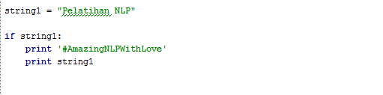
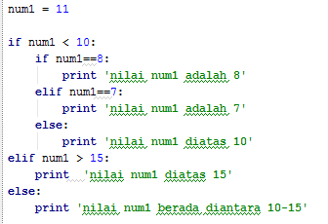
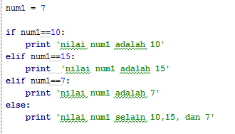
Flow Control

Slide 15
Loops
Loop type
While loop
For loop
Control statement
else
break
continue

Slide 16
Loops
count = 0
while (count < 9):
print 'The count is:', count
count = count + 1
print "Good bye!“
for letter in 'Python':
print 'Current Letter :', letter
for i in range(8):
print 'i :', i
for i in range(4,8):
print i, "is less than 8"
else:
print i, "is not less than 8"
fruits = ['banana', 'apple', 'mango']
for fruit in fruits:
print 'Current fruit :', fruit
count = 0
while count < 5:
print count, "is less than 5"
count = count + 1
else:
print count, "is not less than 5“
for index in range(len(fruits)):
print 'Current fruit :', fruits[index]

Slide 17
Function
def functionname( parameters ):
"function_docstring"
function_suite
return [expression]
Begin with the keyword def followed by the function name
The first statement of a function can be an optional statement - the documentation string of the function or docstring.
The statement return [expression] exits a function, optionally passing back an expression to the caller

Slide 18
Module
Grouping related code into a module
use any Python source file as a module by executing an import statement
Specified by filename
def tambah(angka1, angka2):
return angka1 + angka2
def kurang(angka1, angka2):
return angka1 - angka2
import hitung
print hitung.tambah(3,4)
print hitung.kurang(3,4)
hitung.py

Slide 19
Class
Create new class
Create new Instance
class Mahasiswa:
def __init__ (self, name, nim):
self.name = name
self.nim = nim
def displayMahasiswa(self):
print ("Name : ", self.name, ", Nim: ", self.nim)
m1.displayMahasiswa( )
m2.displayMahasiswa( )
m1.umur = 20
m2.umur = 19
print ( hasattr( m1,'umur') )
print ( hasattr( m2,'hobi') )
setattr( m1,'umur', 21)
setattr( m2,'hobi', 'bersepeda')
print ( getattr( m1,'umur') )
print ( getattr( m2,'hobi') )
print ( delattr( m1,'umur') )
print ( delattr( m2,'hobi') )
Mahasiswa.py
from Mahasiswa import Mahasiswa
m1 = Mahasiswa('budi','110xx1')
m2 = Mahasiswa('erik','110xx2')

Slide 20
Class Inheritance
deriving from a preexisting class by listing the parent class in parentheses after the new class name
class Ayah:
def methodAyah(self):
print "ini method ayah"
class Ibu:
def methodIbu(self):
print "ini method ibu"
class Anak(Ayah,Ibu):
def methodAnak(self):
print "ini method anak"
y = Ayah()
i = Ibu()
a = Anak()
a.methodAyah()
a.methodIbu()
a.methodAnak()

Slide 21
File I/O
The open() Function
Open a file specified by filename
fileobject = open(filename [, access_mode][, buffering])
Access mode | Description
r | Read only
r+ | Read and write
w | Write only, overwrites if already exists, create new if doesn’t exist
w+ | Write and read, overwrites if already exists, create new if doesn’t exist
Access mode | Description
a | Appending, pointer at the end if already exists, create new if doesn’t exist
a+ | Appending and reading, pointer at the end if already exists, create new if doesn’t exist
Access mode | Description
rb | in binary format
rb+
wb
wb+
ab
ab+

Slide 22
File I/O
The close() Function
flushes any unwritten information and closes the file object,
no more writing can be done
The write() Function
writes any string to an open file
The read() Function
reads a string from an open file
Read until count-th character
fileobject.close()
fileobject.write( string )
fileobject.read( [ count ])

Slide 23
File I/O
file = open( "contoh.txt", "w“ )
file.write ( "NLP Training with Love“ )
file.close( )
print "Name of the file: ", file.name
print "Closed or not : ", file.closed
print "Opening mode : ", file.mode
file = open( "contoh.txt", "r“ )
str = file.read( )
print str
file.close( )
file = open("contoh.txt", "r")
str = file.read(7)
print str
str = file.read(3)
print str
print file.tell()
file.seek(0,0)
str = file.read(3)
print str
file.close( )

Slide 24
THANK YOU

Slide 25


Python - just so you know
Python floating point calculation
The internal representation of floating point numbers uses a fixed number of binary digits to represent a decimal number.
Some decimal numbers can’t be represented exactly in binary, resulting in small round off error
Do not compare float using ==

